Slide 1

TOPIC-Word Processing
COURSE: CCC Concept
CHAPTER: 03 (Word Processing )
DAY: 14
NIELIT
Presentation By : Anjali Dhingan

Slide 2
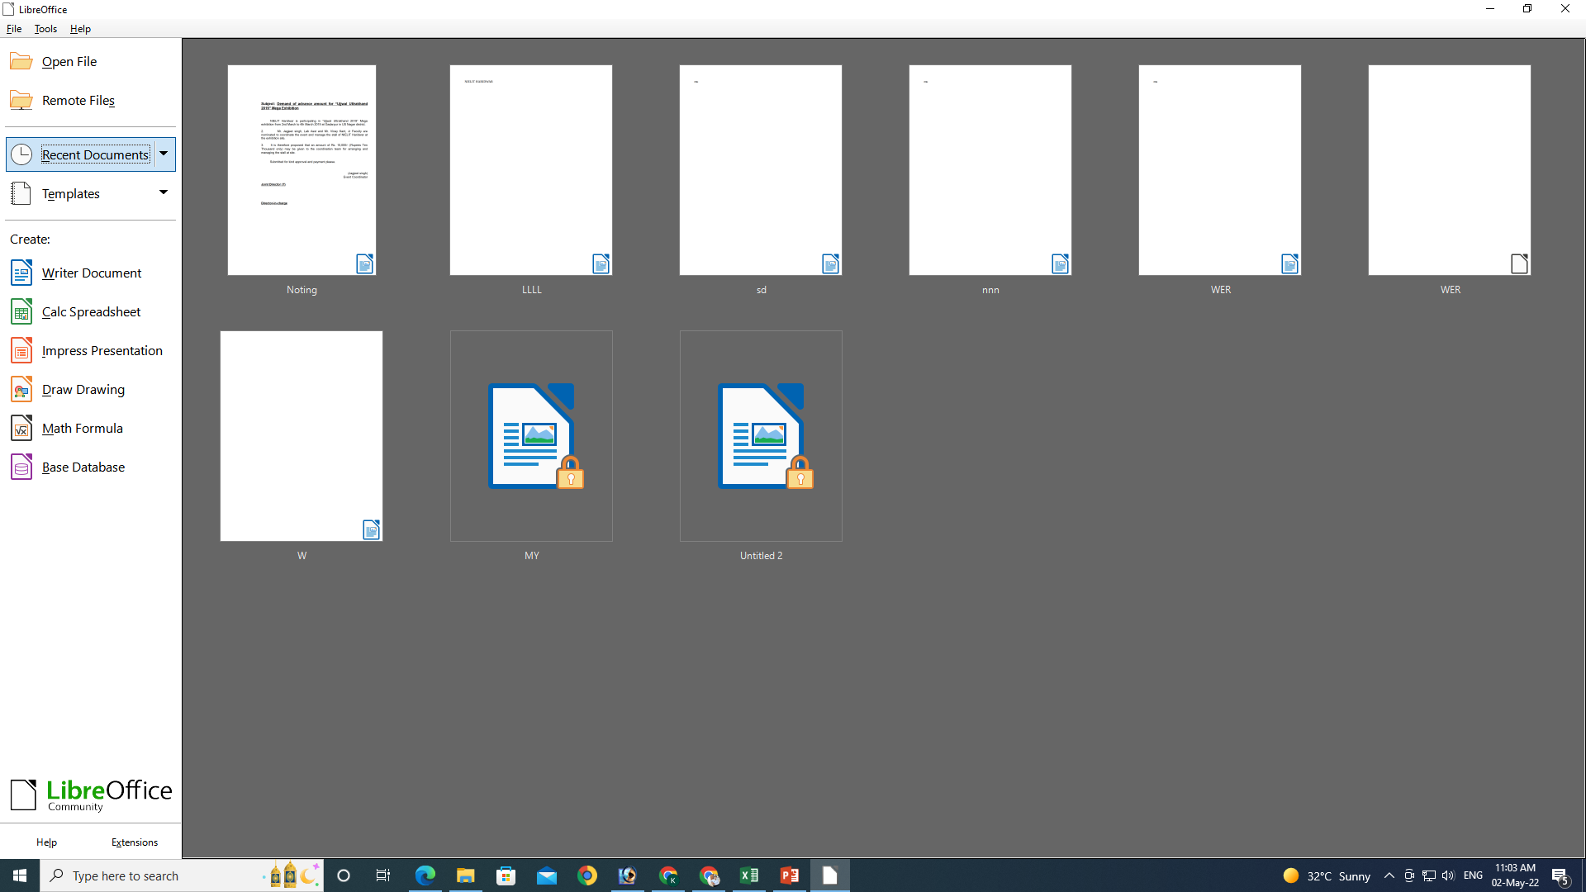
Create New Document

Slide 3
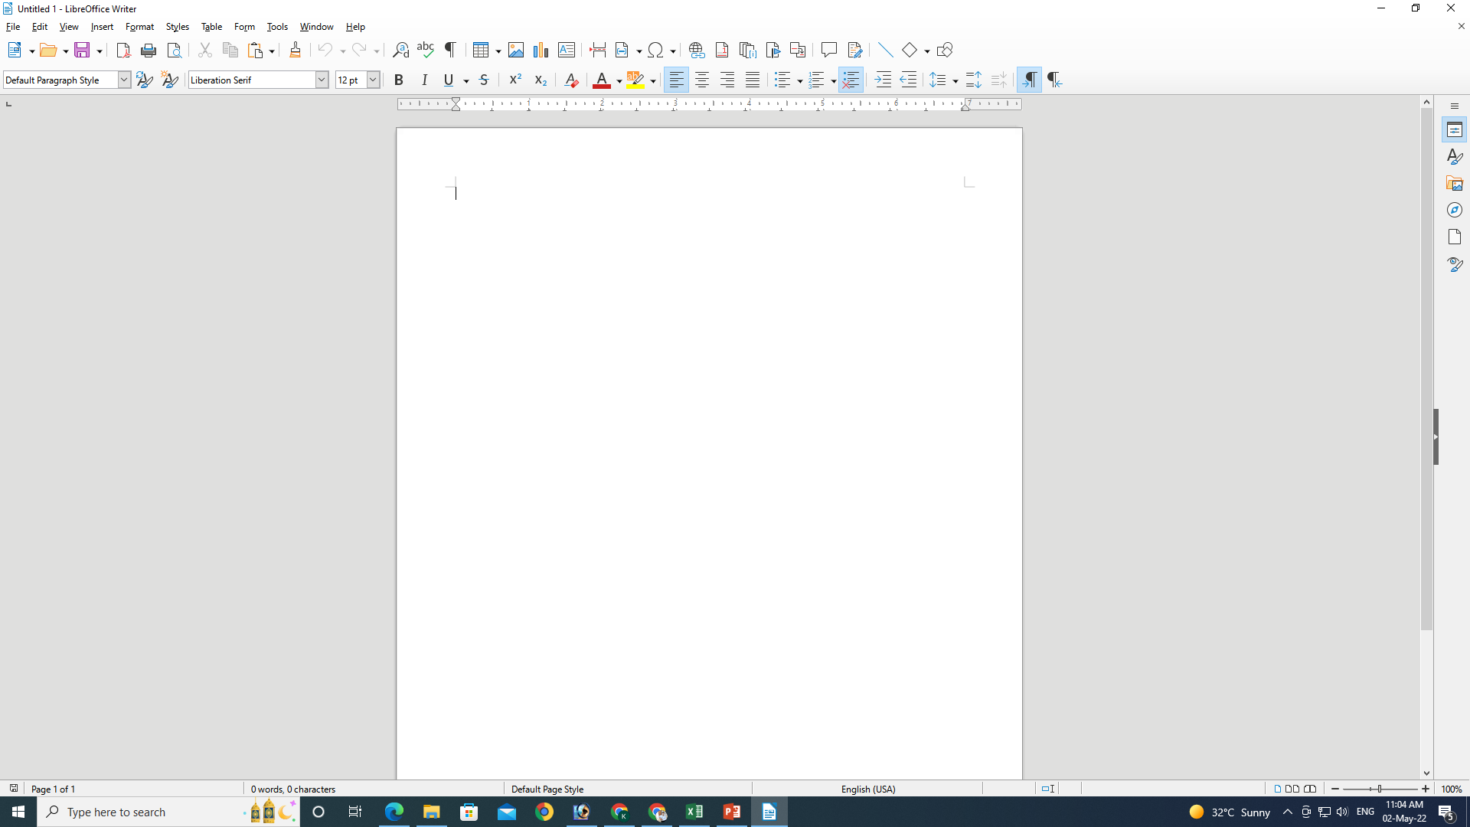
Create New Document

Slide 4
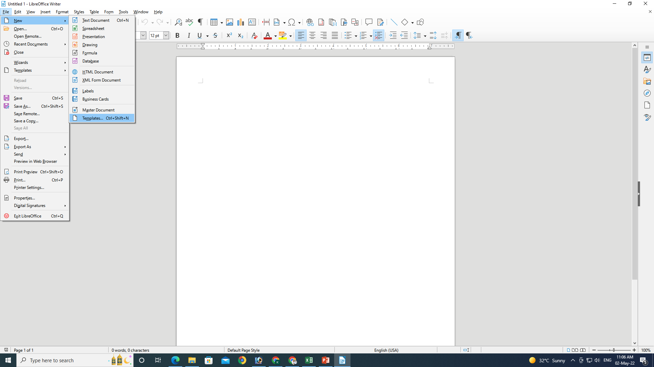
Templates

Slide 5
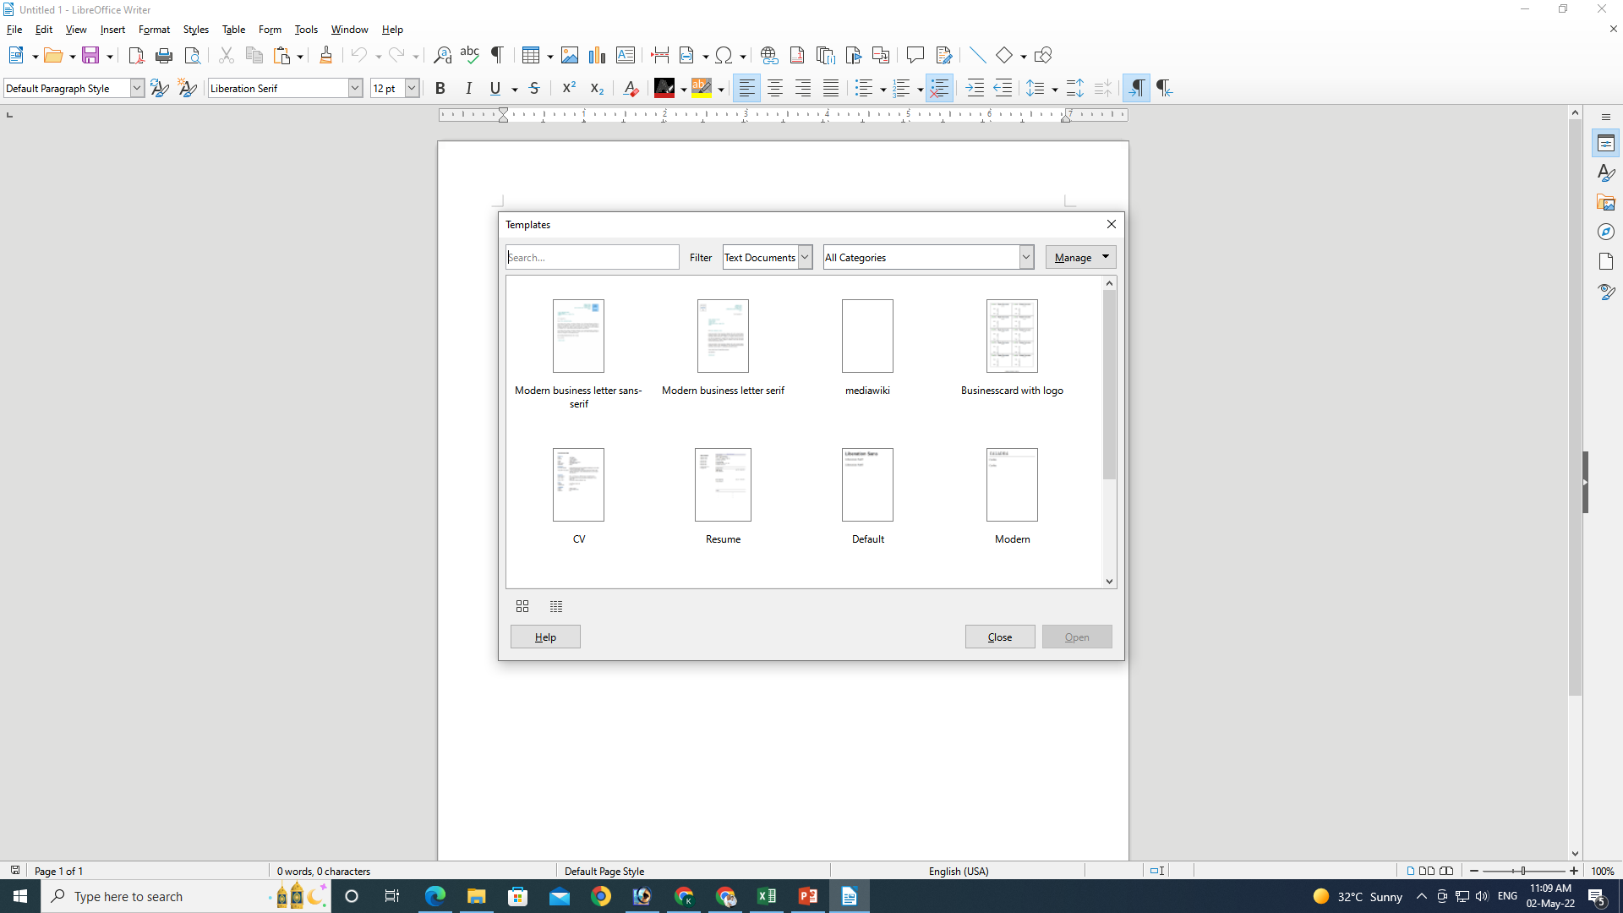
Templates

Slide 6
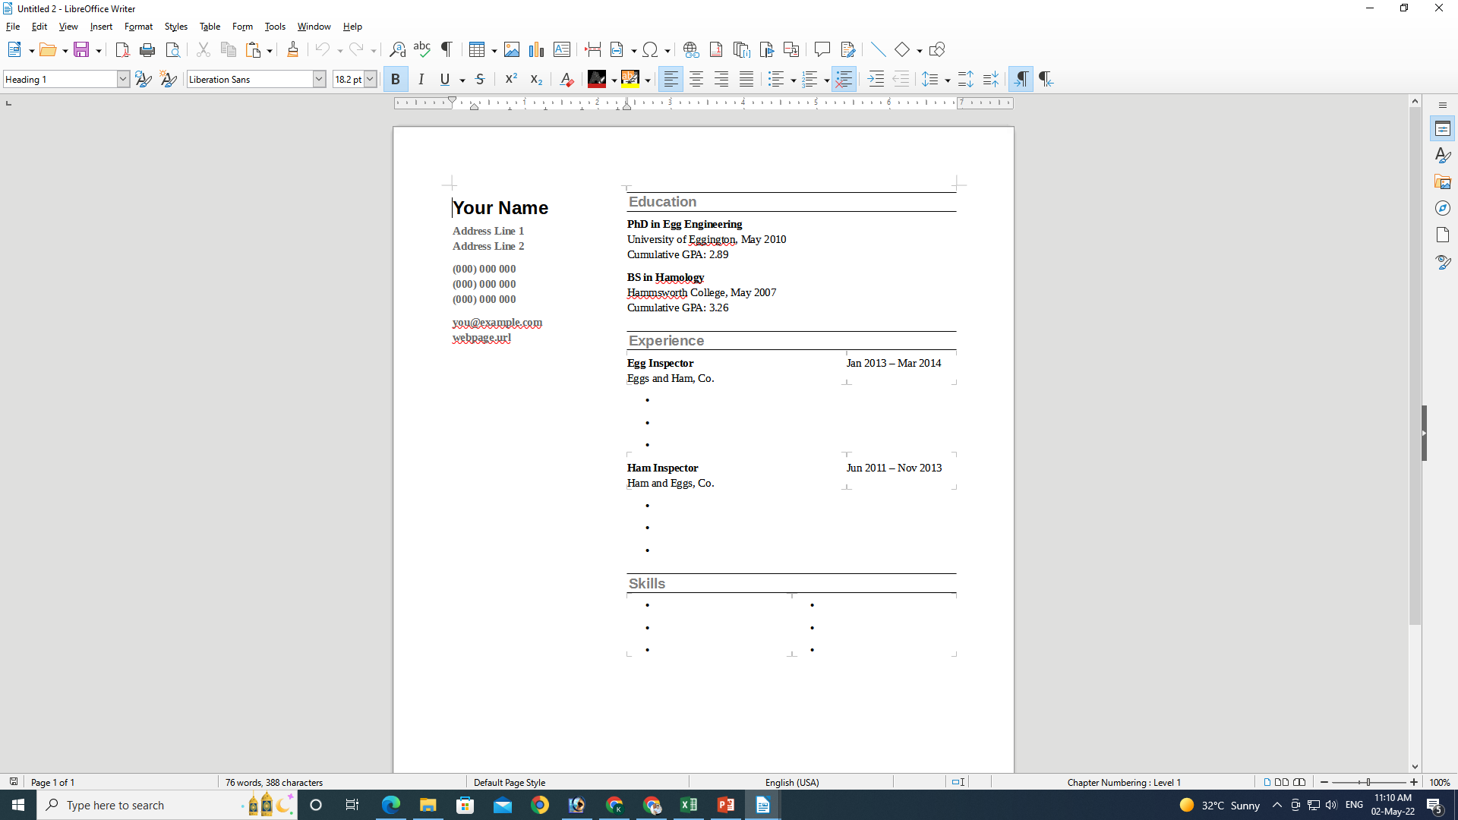
Templates

Slide 7
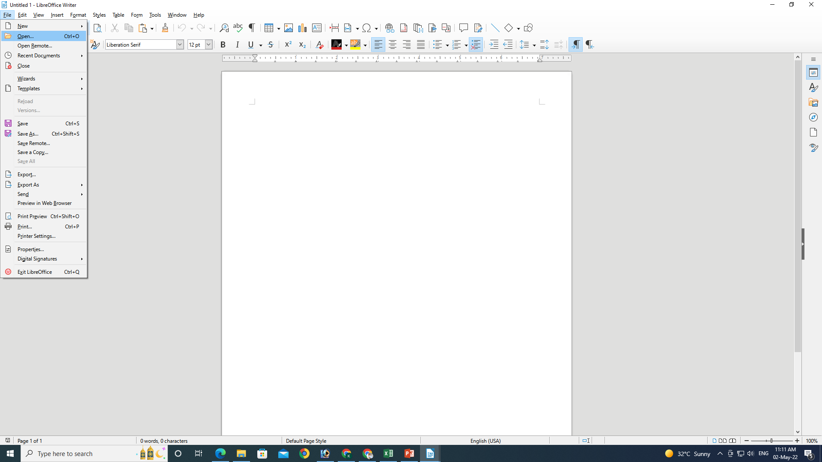
Opening Document
Ctrl+O

Slide 8
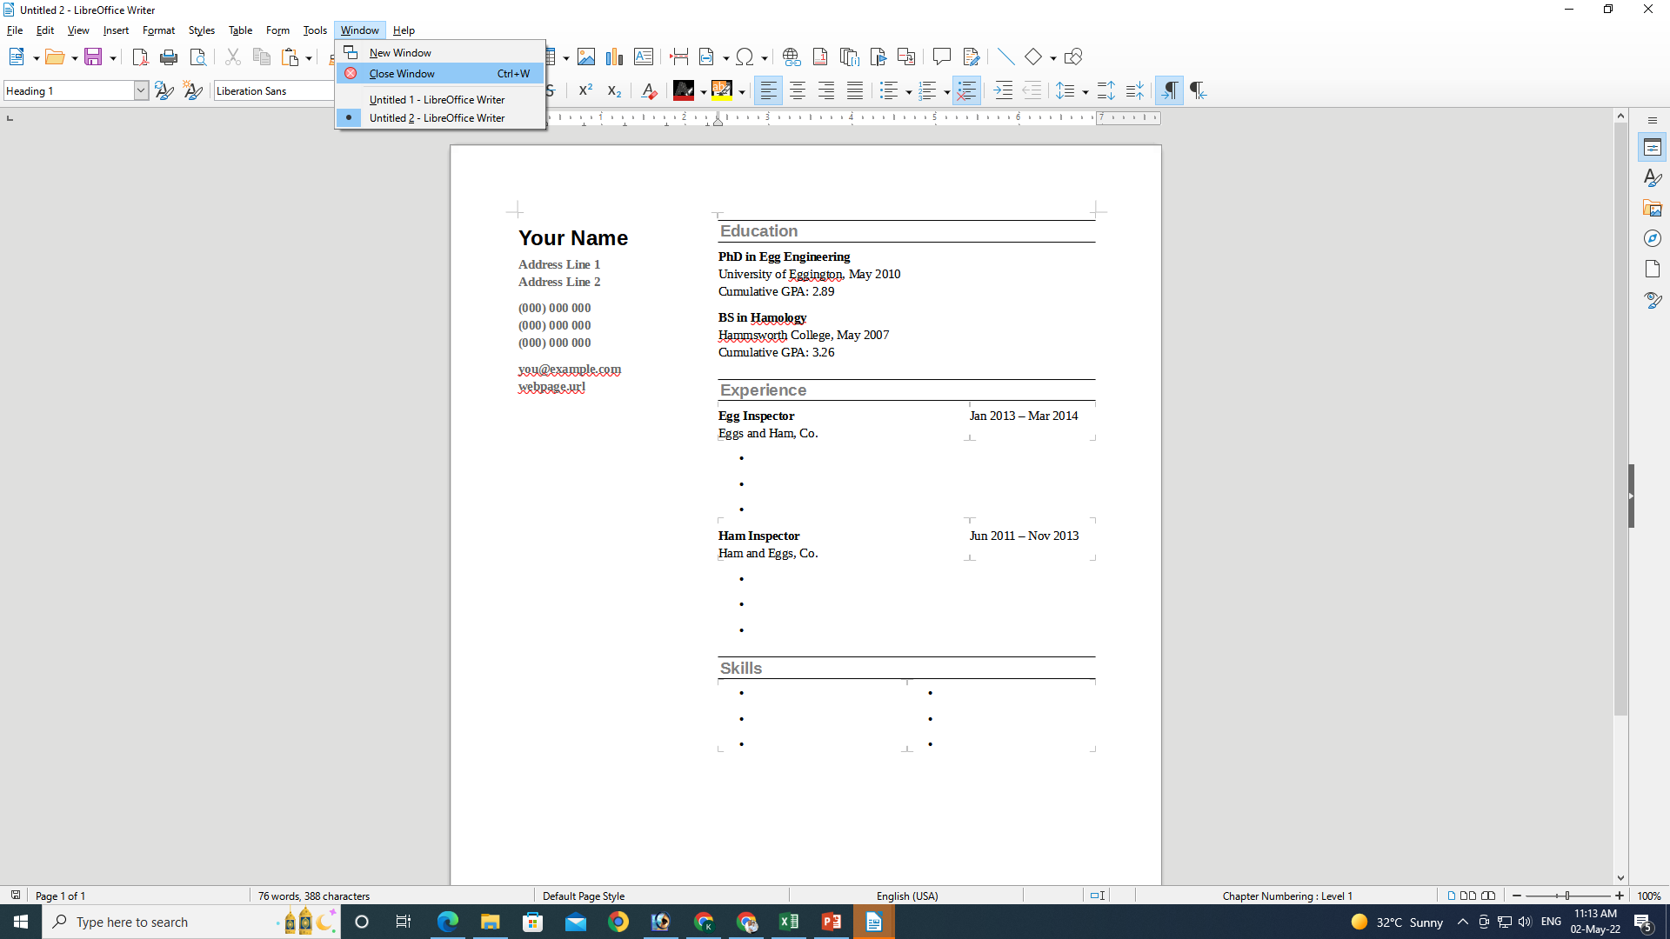
Closing Document
Ctrl+W

Slide 9
Reload
If you modify a document but don’t save it, you can click the Reload item to revert to the version of the document before the changes were made. After clicking this item, a dialog appears asking whether or not you want to cancel the changes.
If you save the document, you cannot use this item to revert to a previous version of the document.
This is available if five of the applications. It is not available in Base.

Slide 10
Open Remote
Open Remote
This opens a dialog that allows you to open documents that are stored on servers, such as Google Drive or an FTP. It is available in Writer, Calc, and Impress.

Slide 11
Recent Documents
Recent Documents
This sub-menu lists up to the last 20 documents that you have opened. It is available in all six applications. It is also available in StartCenter and the Standard toolbar.

Slide 12
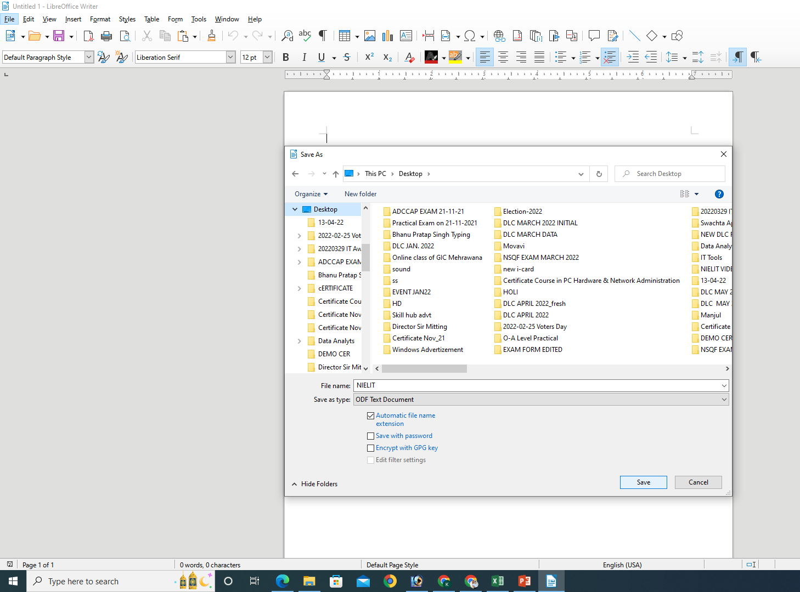
Save & Save As

Slide 13
Save As
Save As
This will prompt you to save the document using a dialog box. You will have the ability to change the file name and/or location. If you choose the same file name and location it will over-write the original. Your working document will be the one you just saved.
Save = Ctrl + S
Save As = Ctrl + Shift + S

Slide 14
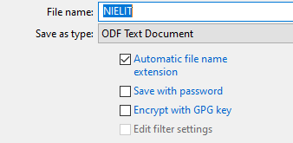
Save & Save As

Slide 15
Save Remote
This opens a Remote Files dialog that allows you to save a document to a server, such as Google Drive or an FTP server.

Slide 16
Save a Copy
This will prompt you to save a ‘copy’ using the same dialog box as ‘save as’. You will have the ability to change the file name and/or location. If you choose the same file name and location it will over-write the original. If you changed the name or location of the document you will be working on the original document not the copy. This means that if you make additional changes and then hit save the original will be overwritten with the new changes, but the copy you saved earlier will be left at the state of the “Save A Copy”.

Slide 17
Save All
This will save all the Libre Office that are open.

Slide 18
Export
Clicking this opens an export dialog that allows you to select where you want to export the document in your hard drive or to an attached drive. The drop-down menu lets you choose the format:
XHTML
PDF
EPUP
JPEG
XML
PNG

Slide 19
Export as PDF
This works like the Save As function, but it converts the document into one of two different formats. This is is a new sub-menu in LibreOffice 6.0 Writer.
Export as PDF: This opens the PDF Options dialog, that allows you to control the exportation with settings in six tabs.
Export Directly as PDF: This will allow you to choose the location where you want the PDF to be exported to. It doesn’t give you any setting options.
Export as EPUB: This opens an EPUB Export dialog that allows you to choose the EPUB version (2.0 or 3.0) and the Split method (Page break and Heading). This is a new item and dialog in version 6.0.
Export Directly as EPUB: This will allow you to choose the location where you want the EPUB document to be exported to. It doesn’t give you any setting options. Version 6.0 is the first version that allows documents to be exported as an EPUB. (Electronic publication)

Slide 20
Send
This allows for various kinds of ways to send your document.
Email as Document: This will open your default email client and send the document in the format it was saved in. If the document is in a Microsoft format, it will be attached in an email as that format. If the document is in an Open Document Format, it will be attached in an email as that format

Slide 21
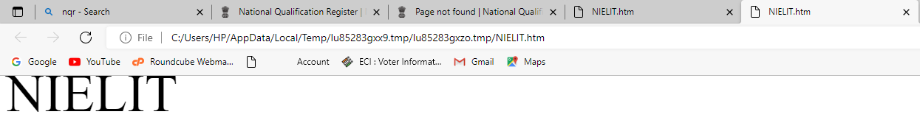
Preview in Web Browser
This opens the document in your default browser.

Slide 22
Print Preview
This shows how the document would look when it is printed. It is the same as the Toggle Print Preview icon in the Standard toolbar. This item is available for the first time in version 6.0. (Ctrl + Shift + O)
Print (Ctrl + P)
This opens the printer dialog that allows you to set what printer to use and gives control over how the document is printed.
Printer Settings
This opens the Printer Setup dialog that allows you to select your desired printer and then click the Options button to choose settings for it.

Slide 23
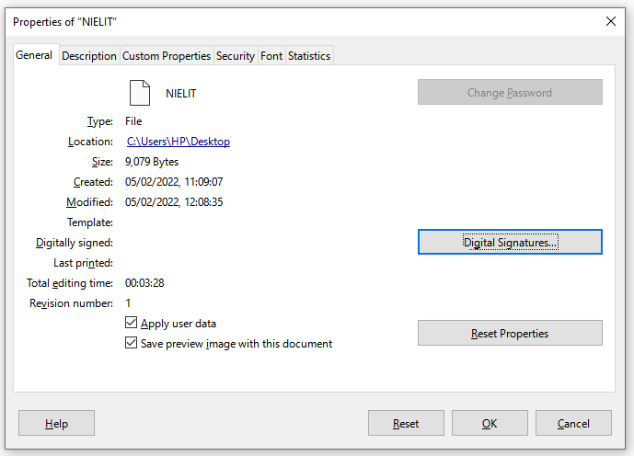
Properties
Clicking this opens the Properties dialog, which has seven tabs with information about the document.
The seven tabs give you information about the document and has settings that can be changed.

Slide 24
Digital Signatures
This sub-menu has two options
Digital Signatures: This opens the Digital Signatures dialog that allows you to view who has signed the document and to sign the current document.
Sign existing PDF: This opens a dialog that allows you to search your hard drive for a PDF.

Slide 25
Thank You
NIELIT

